Slide 2
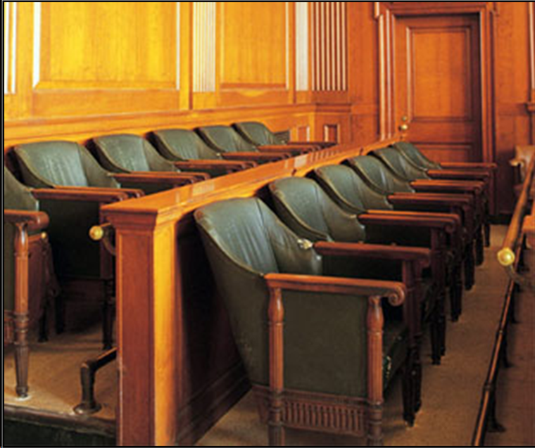

Slide 3
Lou and Joanna Summerlin

Slide 4
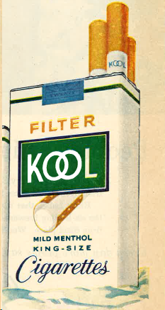
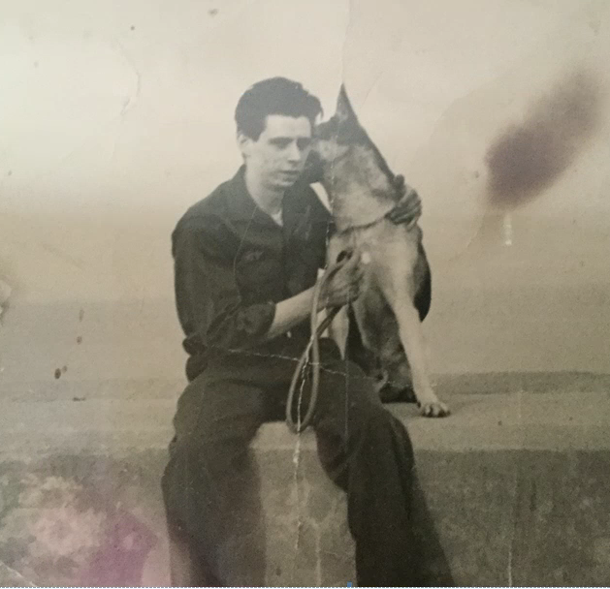
Mr. Summerlin became addicted to Kool menthol cigarettes as a teenager

Slide 5
Brown & Williamson knew that most people started smoking as teenagers

Slide 6
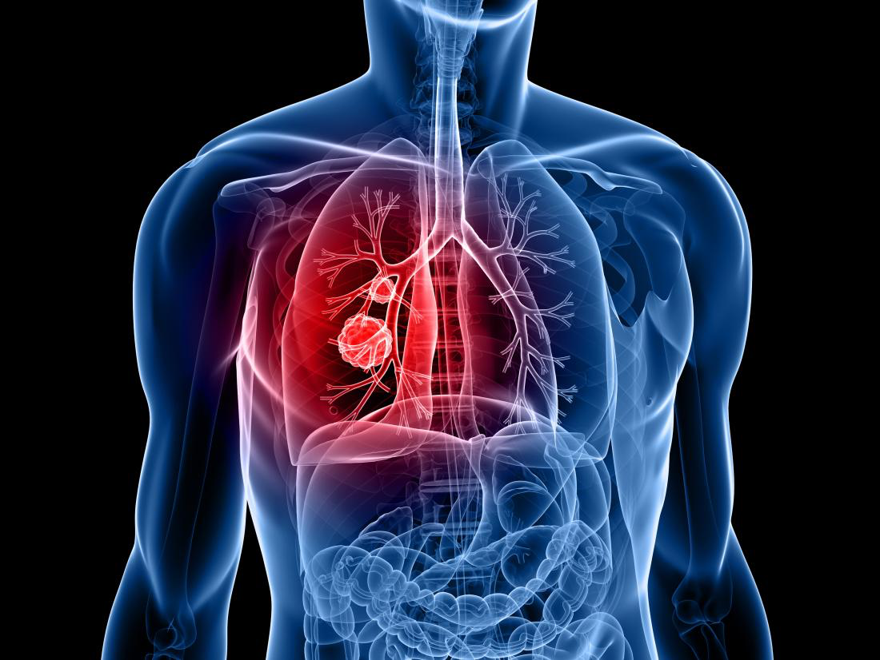
Brown & Williamson knew smoking caused lung cancer

Slide 7
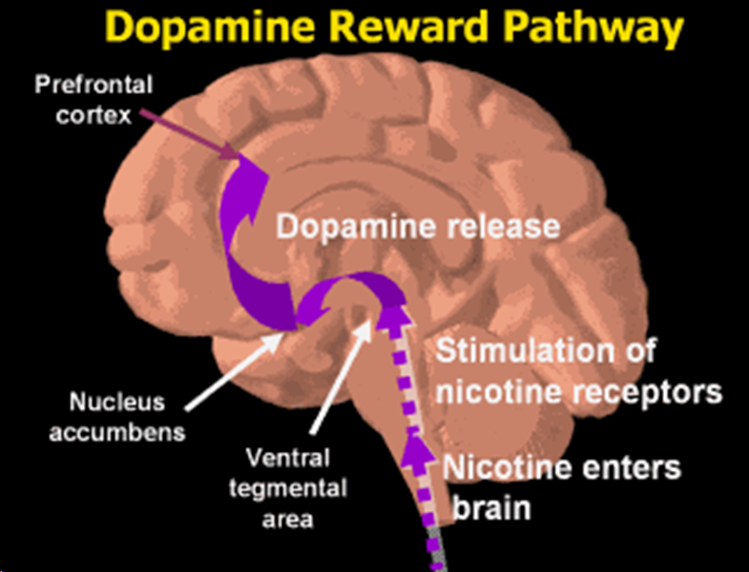
Brown & Williamson knew nicotine was addictive

Slide 8
Mr. Summerlin became addicted to Kool cigarettes before there were warnings
Late 1950s
No warnings
More than 1 pack per day
Lou becomes addicted
Caution: Cigarette Smoking May Be Hazardous To Your Health
1966

Slide 9
Brown & Williamson and R.J. Reynolds concealed the truth from the public
Timothy V. Hartnett
President Brown & Williamson and
Chairman of the Tobacco Industry Research Committee

Slide 10
Lou didn’t know the truth (cancer and addiction) when he became addicted

Slide 11
Mr. Summerlin’s smoking behavior = Addiction
Smoking immediately upon waking
> 1 pack per day
Unsuccessful efforts to quit and Relapse
Nicotine withdrawal symptoms
Denial/Rationalization
Ignored warnings once addicted
Continued use despite negative consequences

Slide 12
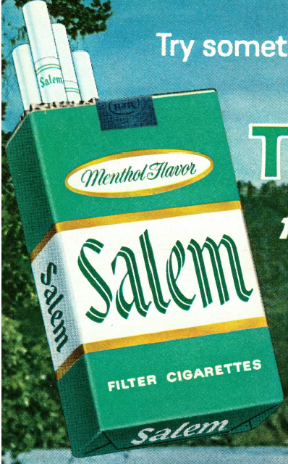
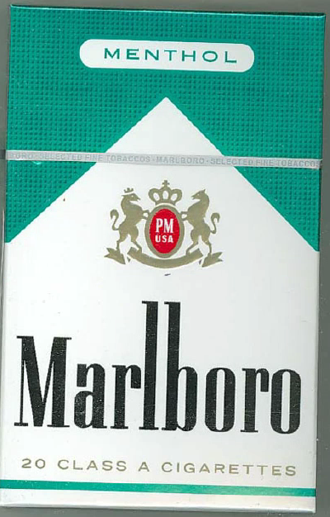
They Intentionally designed the cigarettes that Mr. Summerlin Smoked to be Highly Addictive

Slide 13
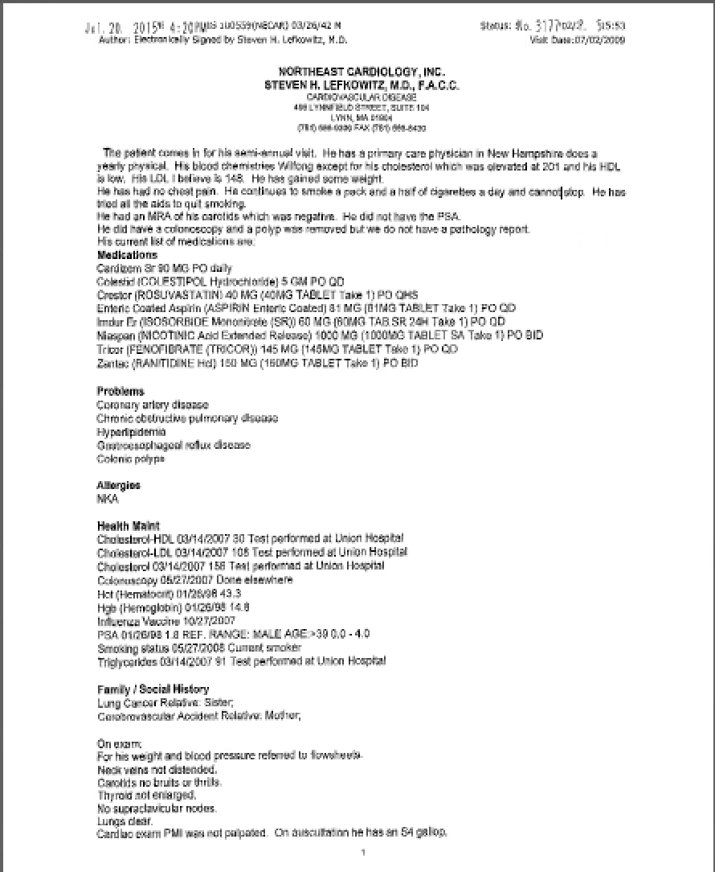
Dr. Lefkowitz (July 2, 2009)
“He continues to smoke a pack and a half of cigarettes a day and cannot stop. He has tried all the aids to quit smoking.”

Slide 14
In August, 2009, Mr. Summerlin permanently stopped smoking after major heart surgery
Lou was hospitalized for 5 days
He was put under “general anethesia” and it was not possible for him to smoke
He was on pain medication and discharged with pain medication (Percocet/Oxycodone)
He was confined in a smoke-free home while recovering from surgery

Slide 15
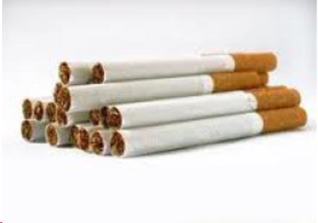
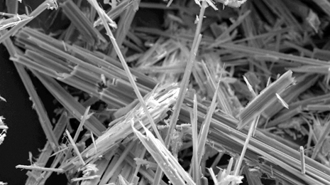
Mr. Summerlin’s lung cancer was caused by Cigarettes and Asbestos

Slide 16
Cigarette Smoke + Asbestos = “Synergy”

Slide 17
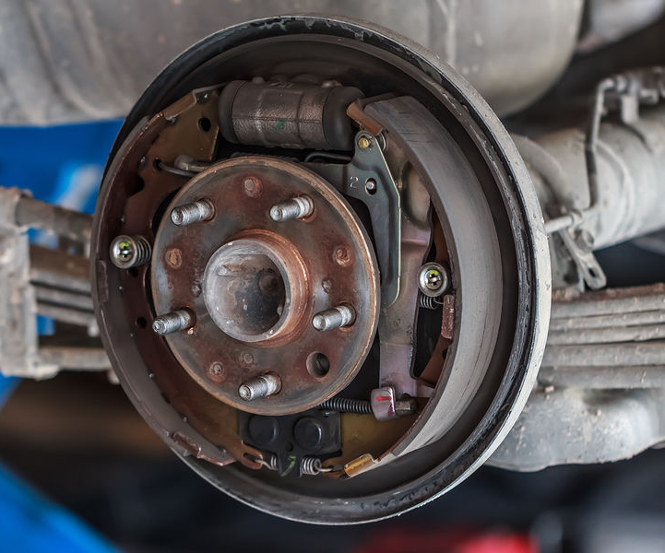
Mr. Summerlin was exposed to asbestos from brakes for close to 25 years
1959 to 1964: New England Brake and Cambridge Brake.
1965 to 1984: Auto City and Concord Auto Auction.
All new brakes at New England Brake Center = Hampden

Slide 18
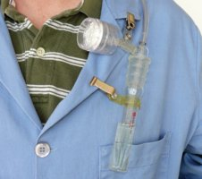
Hampden failed to test and failed to warn

Slide 19
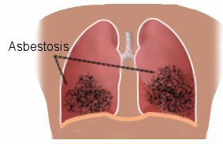
In the early 1900s, asbestos was established as a cause of lung disease

Slide 20
In the 1930s and 1940s, asbestos was established as a cause of lung cancer

Slide 21
Asbestos dust from “brake linings” was identified as a health hazard in the 1930s and 1940s

Slide 22
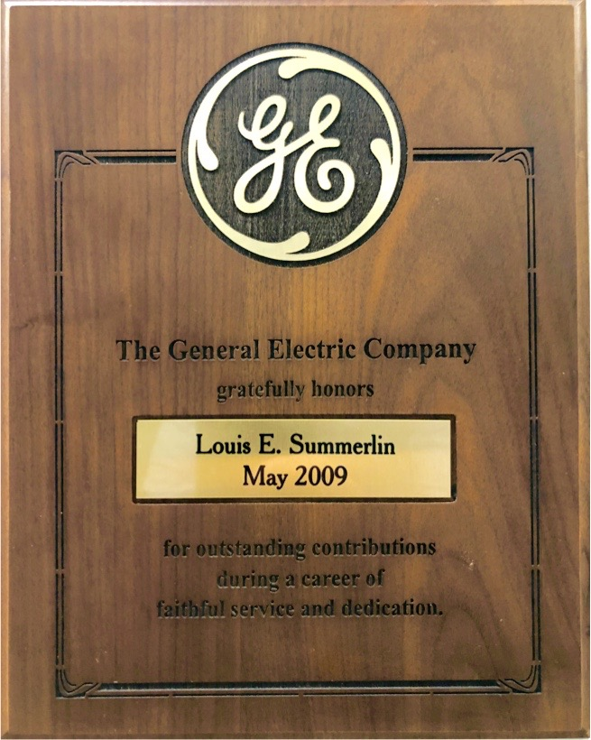
Mr. Summerlin was a hard worker who followed safety rules
“for outstanding contributions during a career of faithful service and dedication”

Slide 23
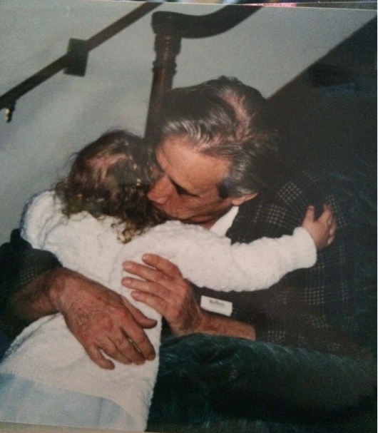
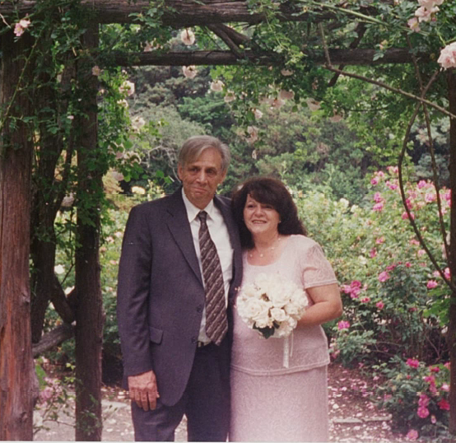
Mr. Summerlin’s family life before lung cancer

Slide 24
In 2015, Lou was diagnosed with lung cancer and suffered severe damages

Slide 25
Mr. Summerlin had his deposition taken for 3 full days, just 2 months before he died

Slide 26
Joanna Summerlin has and will continue to suffer damages

